Slide 1
Final Project Ideas Proposal
Caitlin Bachner - Creative Coding - Fall 2025

Slide 2
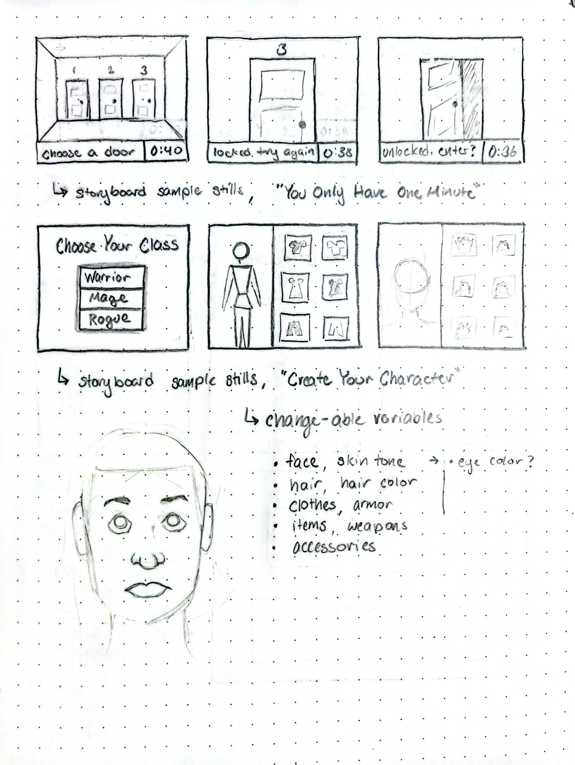
“You Only Have One Minute”
A point and click escape room series, where the solutions are trivial but there is a long series of them, which need to be memorized. Once the sequence of answers is memorized, the game is completable in under a minute.
Inspirations: Life is Strange, Ghost Trick, Outer Wilds, Escape Room Games

Slide 3
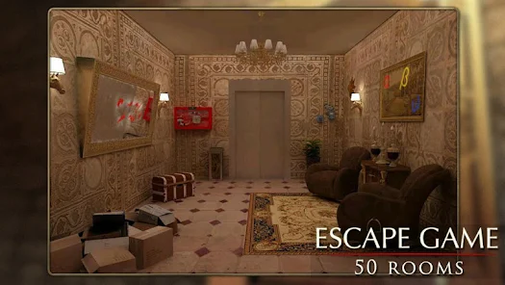
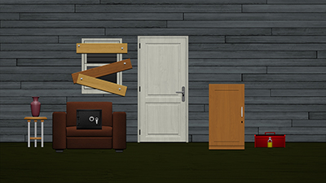
“You Only Have One Minute” Sample Images

Slide 4
“Create Your Character”
An RPG character creator. You are able to choose your character’s class, as well as features and clothing. The game’s images and objects will be drawn and inserted as images.
Inspirations: The Sims, Piccrew, RPGs like Baldur’s Gate & Elden Ring

Slide 5
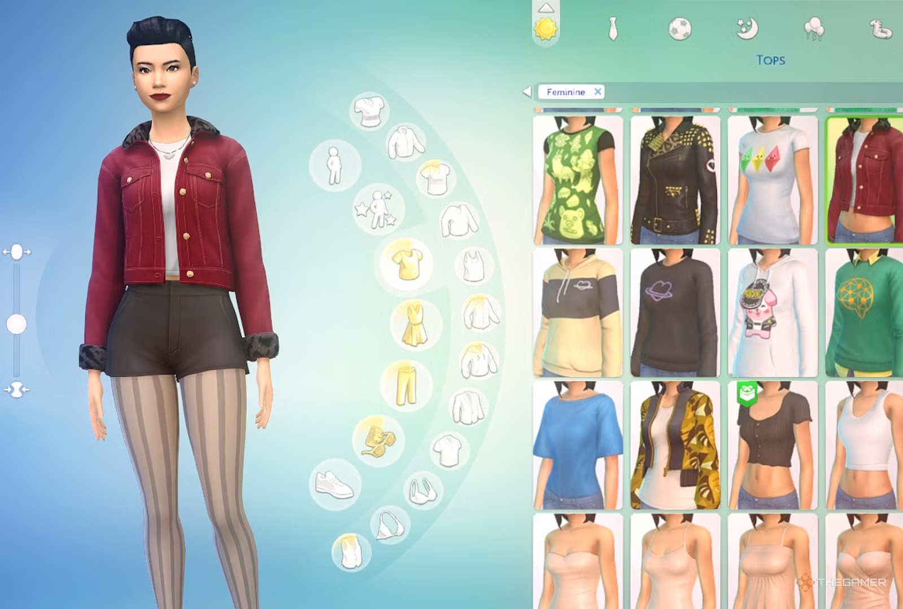
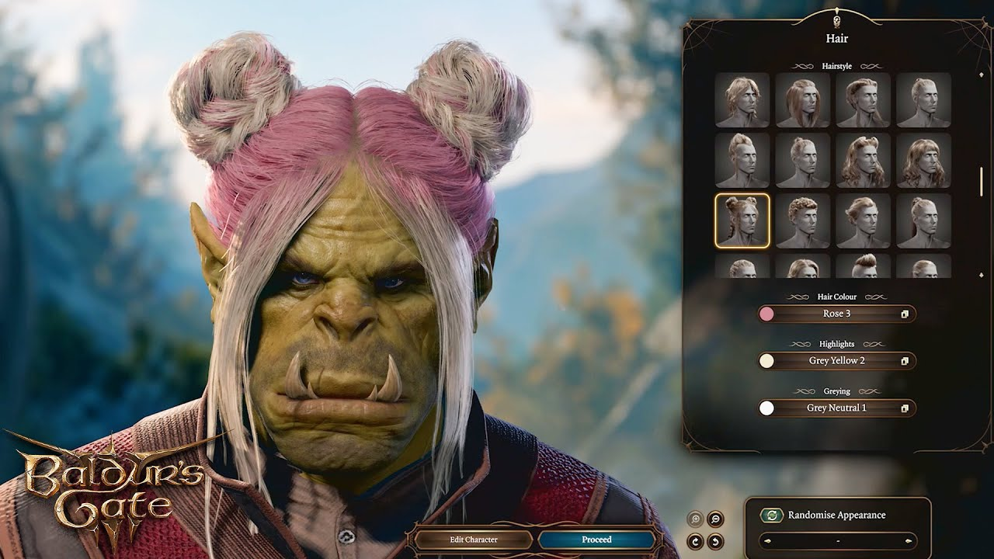
“Create Your Character” Sample Images

Slide 6
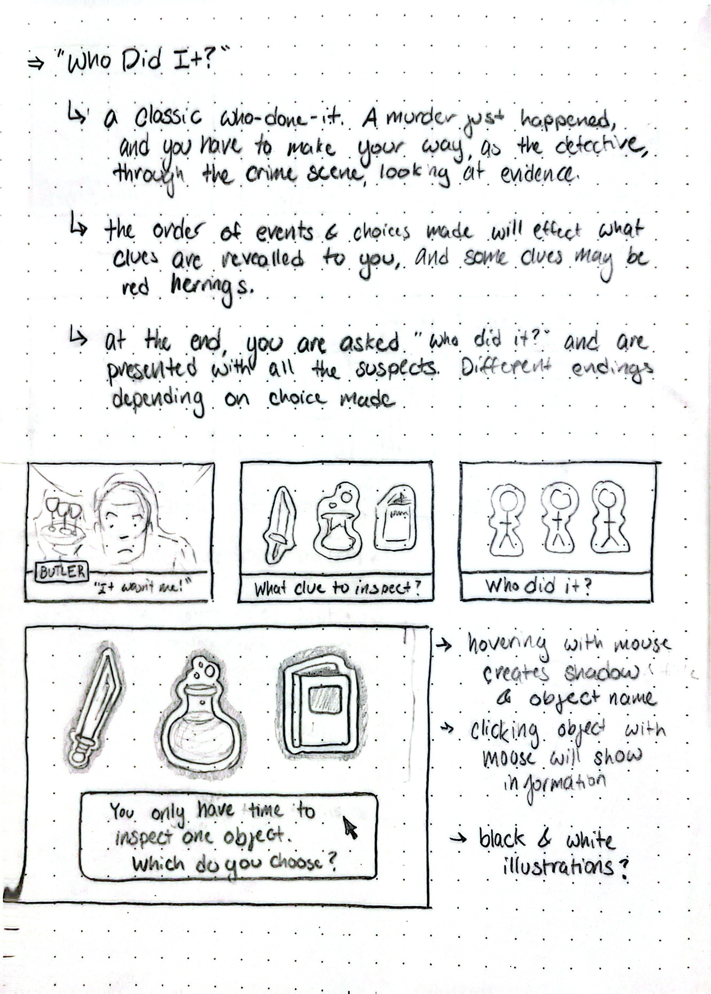
“Who Did It?”
A murder mystery where you play as a detective, investigating a murder. Choices made will affect what clues or red herrings are given, and at the end you must decide who the killer is.
Inspiration: Clue, Agatha Christie, The Blue Prince

Slide 7
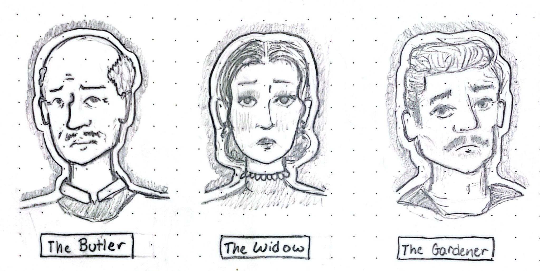
“Who Did It?” Sample Images

